Slide 1
What is Big Data? Gartner Definition
According to Gartner, the definition of Big Data –
“Big data” is high-volume, velocity, and variety information assets that demand cost-effective, innovative forms of information processing for enhanced insight and decision making.”

Slide 2
It refers to a massive amount of data that keeps on growing exponentially with time.
It is so voluminous that it cannot be processed or analyzed using conventional data processing techniques.
It includes data mining, data storage, data analysis, data sharing, and data visualization.
The term is an all-comprehensive one including data, data frameworks, along with the tools and techniques used to process and analyze the data.

Slide 3
Types of Big Data
Structured
Structured is one of the types of big data and By structured data, we mean data that can be processed, stored, and retrieved in a fixed format. It refers to highly organized information that can be readily and seamlessly stored and accessed from a database by simple search engine algorithms. For instance, the employee table in a company database will be structured as the employee details, their job positions, their salaries, etc., will be present in an organized manner.

Slide 4
Unstructured
Unstructured data refers to the data that lacks any specific form or structure whatsoever. This makes it very difficult and time-consuming to process and analyze unstructured data. Email is an example of unstructured data. Structured and unstructured are two important types of big data.

Slide 5
Semi-structured
Semi structured is the third type of big data. Semi-structured data pertains to the data containing both the formats mentioned above, that is, structured and unstructured data. To be precise, it refers to the data that although has not been classified under a particular repository (database), yet contains vital information or tags that segregate individual elements within the data. Thus we come to the end of types of data. Lets discuss the characteristics of data

Slide 6
Characteristics of Big Data
Back in 2001, Gartner analyst Doug Laney listed the 3 ‘V’s of Big Data – Variety, Velocity, and Volume.

Slide 7
1) Variety
Variety of Big Data refers to structured, unstructured, and semistructured data that is gathered from multiple sources. While in the past, data could only be collected from spreadsheets and databases, today data comes in an array of forms such as emails, PDFs, photos, videos, audios, SM posts, and so much more. Variety is one of the important characteristics of big data.

Slide 8
2) Velocity
Velocity essentially refers to the speed at which data is being created in real-time. In a broader prospect, it comprises the rate of change, linking of incoming data sets at varying speeds, and activity bursts.

Slide 9
3) Volume
Volume is one of the characteristics of big data. We already know that Big Data indicates huge ‘volumes’ of data that is being generated on a daily basis from various sources like social media platforms, business processes, machines, networks, human interactions, etc. Such a large amount of data are stored in data warehouses. Thus comes to the end of characteristics of big data.

Slide 10
Advantages of Big Data (Features)
One of the biggest advantages of Big Data is predictive analysis. Big Data analytics tools can predict outcomes accurately, thereby, allowing businesses and organizations to make better decisions, while simultaneously optimizing their operational efficiencies and reducing risks.

Slide 11
By harnessing data from social media platforms using Big Data analytics tools, businesses around the world are streamlining their digital marketing strategies to enhance the overall consumer experience. Big Data provides insights into the customer pain points and allows companies to improve upon their products and services.

Slide 12
Being accurate, Big Data combines relevant data from multiple sources to produce highly actionable insights. Almost 43% of companies lack the necessary tools to filter out irrelevant data, which eventually costs them millions of dollars to hash out useful data from the bulk. Big Data tools can help reduce this, saving you both time and money.

Slide 13
Big Data analytics could help companies generate more sales leads which would naturally mean a boost in revenue. Businesses are using Big Data analytics tools to understand how well their products/services are doing in the market and how the customers are responding to them. Thus, the can understand better where to invest their time and money.

Slide 14
With Big Data insights, you can always stay a step ahead of your competitors. You can screen the market to know what kind of promotions and offers your rivals are providing, and then you can come up with better offers for your customers. Also, Big Data insights allow you to learn customer behavior to understand the customer trends and provide a highly ‘personalized’ experience to them.

Slide 15
Applications
Healthcare
Academia
Banking
Manufacturing
IT Sector
Retail
Transportation

Slide 16
Big Data Case studies
1. Walmart
Walmart leverages Big Data and Data Mining to create personalized product recommendations for its customers. With the help of these two emerging technologies, Walmart can uncover valuable patterns showing the most frequently bought products, most popular products, and even the most popular product bundles (products that complement each other and are usually purchased together).
Based on these insights, Walmart creates attractive and customized recommendations for individual users. By effectively implementing Data Mining techniques, the retail giant has successfully increased the conversion rates and improved its customer service substantially. Furthermore, Walmart uses Hadoop and NoSQL technologies to allow customers to access real-time data accumulated from disparate sources

Slide 17
Uber
Uber is one of the major cab service providers in the world. It leverages customer data to track and identify the most popular and most used services by the users. Once this data is collected, Uber uses data analytics to analyze the usage patterns of customers and determine which services should be given more emphasis and importance.
Apart from this, Uber uses Big Data in another unique way. Uber closely studies the demand and supply of its services and changes the cab fares accordingly. It is the surge pricing mechanism that works something like this – suppose when you are in a hurry, and you have to book a cab from a crowded location, Uber will charge you double the normal amount!

Slide 18
Netflix
Netflix is one of the most popular on-demand online video content streaming platform used by people around the world. Netflix is a major proponent of the recommendation engine. It collects customer data to understand the specific needs, preferences, and taste patterns of users. Then it uses this data to predict what individual users will like and create personalized content recommendation lists for them.
Today, Netflix has become so vast that it is even creating unique content for users. Data is the secret ingredient that fuels both its recommendation engines and new content decisions. The most pivotal data points used by Netflix include titles that users watch, user ratings, genres preferred, and how often users stop the playback, to name a few. Hadoop, Hive, and Pig are the three core components of the data structure used by Netflix.

Slide 19
Hadoop Architecture

Slide 20
What is Hadoop?
Hadoop is an open source framework, from the Apache foundation, capable of processing large amounts of heterogeneous data sets in a distributed fashion across clusters of commodity computers and hardware using a simplified programming model. Hadoop provides a reliable shared storage and analysis system.

Slide 21
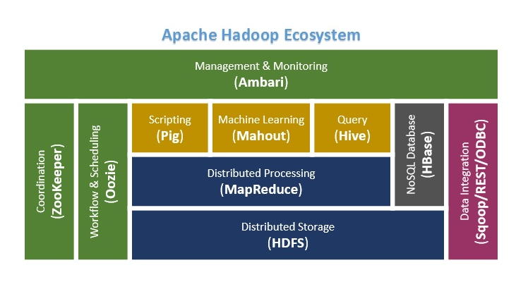

Slide 22
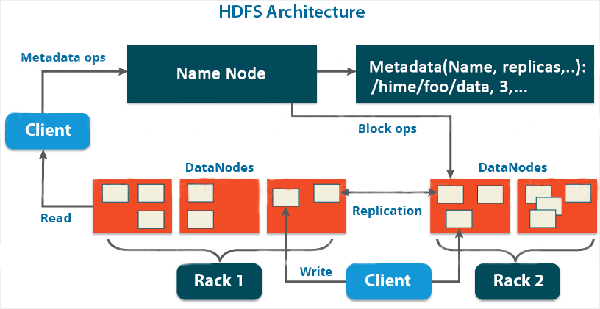

Slide 23
Objectives and Assumptions Of HDFS
1. System Failure: As a Hadoop cluster is consists of Lots of nodes with are commodity hardware so node failure is possible, so the fundamental goal of HDFS figure out this failure problem and recover it.
2. Maintaining Large Dataset: As HDFS Handle files of size ranging from GB to PB, so HDFS has to be cool enough to deal with these very large data sets on a single cluster.
3. Moving Data is Costlier then Moving the Computation: If the computational operation is performed near the location where the data is present then it is quite faster and the overall throughput of the system can be increased along with minimizing the network congestion which is a good assumption.
4. Portable Across Various Platform: HDFS Posses portability which allows it to switch across diverse Hardware and software platforms.
5. Simple Coherency Model: A Hadoop Distributed File System needs a model to write once read much access for Files. A file written then closed should not be changed, only data can be appended. This assumption helps us to minimize the data coherency issue. MapReduce fits perfectly with such kind of file model.

Slide 24
NameNode
HDFS works in a master-slave/master-worker fashion. All the metadata related to HDFS including the information about data nodes, files stored on HDFS, and Replication, etc. are stored and maintained on the NameNode. A NameNode serves as the master and there is only one NameNode per cluster.
DataNode
DataNode is the slave/worker node and holds the user data in the form of Data Blocks. There can be any number of DataNodes in a Hadoop Cluster.
Data Block
A Data Block can be considered as the standard unit of data/files stored on HDFS. Each incoming file is broken into 64 MB by default. Any file larger than 64 MB is broken down into 64 MB blocks and all the blocks which make up a particular file are of the same size (64 MB) except for the last block which might be less than 64 MB depending upon the size of the file.
Replication
Data blocks are replicated across different nodes in the cluster to ensure a high degree of fault tolerance. Replication enables the use of low cost commodity hardware for the storage of data. The number of replicas to be made/maintained is configurable at the cluster level as well as for each file. Based on the Replication Factor, each file (data block which forms each file) is replicated many times across different nodes in the cluster.
Rack Awareness
Data is replicated across different nodes in the cluster to ensure reliability/fault tolerance. Replication of data blocks is done based on the location of the data node, so as to ensure high degree of fault tolerance. For instance, one or two copies of data blocks are stored on the same rack, one copy is stored on a different rack within the same data center, one more block on a rack in a different data center, and so on.

Slide 25
Master-Slave/Master-Worker Architecture
HDFS works in a master-slave/master-worker fashion.
NameNode servers as the master and each DataNode servers as a worker/slave.
NameNode and each DataNode have built-in web servers.
NameNode is the heart of HDFS and is responsible for various tasks including - it holds the file system namespace, controls access to file system by the clients, keeps track of the DataNodes, keeps track of replication factor and ensures that it is always maintained.
User data is stored on the local file system of DataNodes. DataNode is not aware of the files to which the blocks stored on it belong to. As a result of this, if the NameNode goes down then the data in HDFS is non-usable as only the NameNode knows which blocks belong to which file, where each block located etc.
NameNode can talk to all the live DataNodes and the live DataNodes can talk to each other.
There is also a Secondary NameNode which comes in handy when the Primary NameNode goes down. Secondary NameNode can be brought up to bring the cluster online. This process of switching of nodes needs to be done manually and there is no automatic failover mechanism in place.
NameNode receives heartbeat signals and a Block Report periodically from each of the DataNodes.
Heartbeat signals from a DataNode indicates that the corresponding DataNode is alive and is working fine. If a heartbeat signal is not received from a DataNode then that DataNode is marked as dead and no further I/O requests are sent to that DataNode.
Block Report from each DataNode contains a list of all the blocks that are stored on that DataNode.
Heartbeat signals and Block Reports received from each DataNode help the NameNode to identify any potential loss of Blocks/Data and to replicate the Blocks to other active DataNodes in the event when one or more DataNodes holding the data blocks go down.

Slide 26
When Not to Use HDFS
There are certain scenarios in which HDFS may not be a good fit including the following:
HDFS is not suitable for storing data related to applications requiring low latency data access.
HDFS is not suitable for storing a large number of small files as the metadata for each file needs to be stored on the NameNode and is held in memory.
HDFS is not suitable for scenarios requiring multiple/simultaneous writes to the same file.

Slide 27
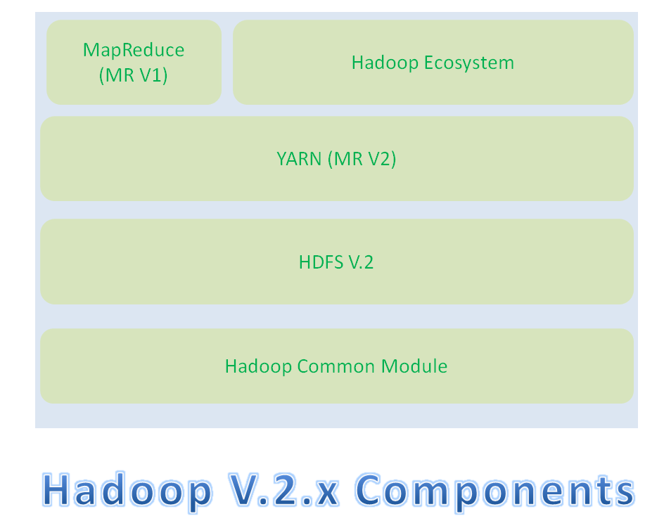

Slide 28
Hadoop Common Module is a Hadoop Base API (A Jar file) for all Hadoop Components. All other components works on top of this module.
HDFS stands for Hadoop Distributed File System. It is also know as HDFS V2 as it is part of Hadoop 2.x with some enhanced features. It is used as a Distributed Storage System in Hadoop Architecture.
YARN stands for Yet Another Resource Negotiator. It is new Component in Hadoop 2.x Architecture. It is also know as “MR V2”.
MapReduce is a Batch Processing or Distributed Data Processing Module. It is also know as “MR V1” as it is part of Hadoop 1.x with some updated features.
Remaining all Hadoop Ecosystem components work on top of these three major components: HDFS, YARN and MapReduce.

Slide 29
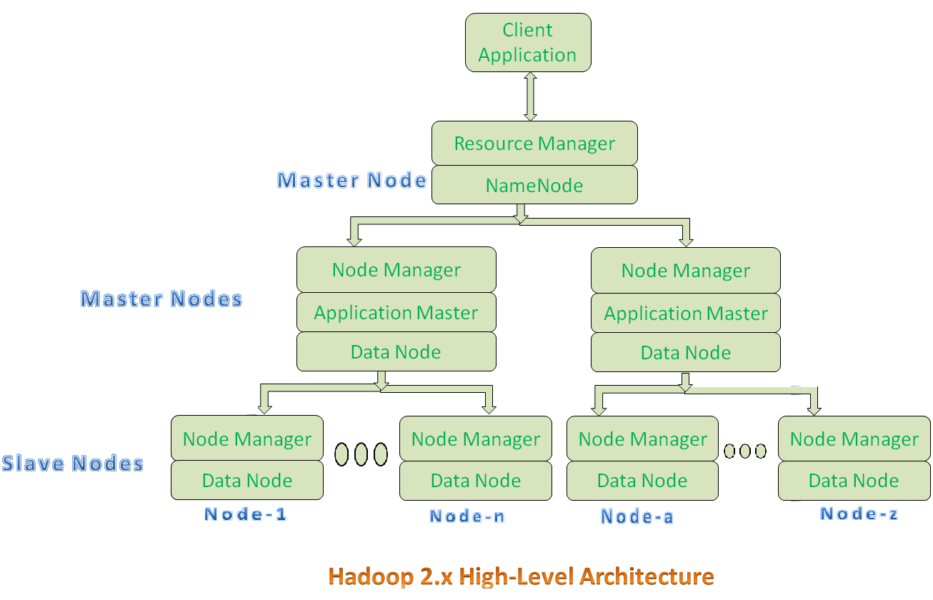

Slide 30
Resource Manager:
Resource Manager is a Per-Cluster Level Component.
Resource Manager is again divided into two components:
Scheduler
Application Manager
Resource Manager’s Scheduler is :
Responsible to schedule required resources to Applications (that is Per-Application Master).
It does only scheduling.
It does care about monitoring or tracking of those Applications.

Slide 31
Application Master:
Application Master is a per-application level component. It is responsible for:
Managing assigned Application Life cycle.
It interacts with both Resource Manager’s Scheduler and Node Manager
It interacts with Scheduler to acquire required resources.
It interacts with Node Manager to execute assigned tasks and monitor those task’s status.

Slide 32
Node Manager:
Node Manager is a Per-Node Level component.
It is responsible for:
Managing the life-cycle of the Container.
Monitoring each Container’s Resources utilization.

Slide 33
Container:
Each Master Node or Slave Node contains set of Containers. In this diagram, Main Node’s Name Node is not showing the Containers. However, it also contains a set of Containers.
Container is a portion of Memory in HDFS (Either Name Node or Data Node).
In Hadoop 2.x, Container is similar to Data Slots in Hadoop 1.x. We will see the major differences between these two Components: Slots Vs Containers in my coming posts.

Slide 34
References
HDFS Architecture Guide: http://hadoop.apache.org/docs/stable1/hdfs_design.html
For latest and up to date information, visit http://hadoop.apache.org

Slide 35
Reference book
mmds.org
Mining of Massive Datasets
Jure Leskovec, Anand Rajaraman, Jeff Ullman

